Slide 1
ACIC Automatic Cloud I/O Configurator for HPC Applications
Mingliang Liu*, Ye Jin^, Jidong Zhai*, Yan Zhai*, Qianqian Shi*, Xiaosong Ma^, Wenguang Chen*
*Tsinghua University
^North Carolina State University

Slide 2
Background
HPC in Cloud
Dedicated for high-end cloud computing in science
Trend to migrate HPC applications to cloud
Notes:
As the cloud computing becomes increasingly popular, cloud providers begin to support dedicated instances for high-end cloud computing in science.
Thus there is a trend that HPC users are migrating their applications from traditional HPC resources to cloud。

Slide 3
HPC in Cloud – pros and cons
Local Clusters
Dedicated IB network
Run at physical machine
Fixed nodes types/numbers
Shared OS / file system / libraries
Gap between I/O and computation
Fixed device types/numbers
One-size-fits-all configuration
Per-platform configuring options
HPC in Cloud ^{[Yan’11]}
Shared 10Gb Ethernet
Virtualization overhead
Online instance acquisition
Fully controlled virtual machines
I/O overhead by virtualization
Multiple device/QoS choice
Application specific configuration
Shared cloud options by all users
Key Idea: Help users find desired I/O system configurations
Notes:
But the HPC in cloud has not grabbed everyone’s mind.
We compared the cloud platform with the local clusters and list the pros and cons.
There are disadvantages of HPC cloud such as the shared 10 Gb Ethernet and virtualization overhead.
While, there are advantages as well.
For example, local clusters have fixed types and numbers of nodes but the we can acquire more instances online and it charges us in a pay-as-you-go approach.
However, there I/O gap in the local clusters is enlarged in cloud.
Fortunately, there are some further potentials which may make the cloud more competitive.
For example, cloud provides multiple device/instance/QoS choices.
We can configure the cloud according to our application’s needs.
As to the configuration options, they are shared by all users of the same cloud,
which makes it possible to reuse the configuration efforts and amortize the cost.

Slide 4
Does I/O Configuration Matter?
BTIO application with 6 I/O configurations. The lower the better
Configurations differ in performance and cost [Mingliang’11]
No single I/O system configuration beats all
Optimal configurations for performance and cost contradict
Notes:
A question is proposed before we move on: does I/O configuration matter?
Here is our preliminary results.
We run the BT-IO of NPB benchmark with 6 I/O configurations varying
File system type (PVFS2 vs. NFS)
I/O servers (1, 2, or 4) numbers
And their placement strategy (dedicated vs. part-time)
Each line in the above figures indicates the result of one configuration.
The y axis is the total execution time or the cost of one run.
The x axis is the number of processes.
We can see from the figures that: 1, 2, 3.

Slide 5
Outline
Motivation
Challenges
Methodology
Evaluation
Conclusion
Notes:
Here is the out line of this talk.
After introduced the motivation,
we define the problem and then propose our tool to address it.
We will show some interesting results and conclude it briefly.

Slide 6
10 Gb Ethernet
PVFS
PVFS
EBS
EBS
Compute Instances…
Ephemeral
Ephemeral
NFS Server
PVFS Server
EBS
PVFS Server
EBS

Slide 7
What Can We Configure?
File System | File system internal parameters (Stripe Size: 64KB/4MB)
 | File system (NFS vs. PVFS2)
I/O Server | I/O server number (1/2/4) | I/O server placement (Dedicated vs. Part-time)
Storage Device | Software RAID (RAID 0 vs. No RAID) | Device number (1/2)
 | Cloud storage device type (EBS vs. Ephemeral vs. SSD)
Notes:
This figure shows the configuration stack of Amazon EC2 platform.
There are three categories, the first one is the storage device configurations, the second is the file system and server configuration and the third are the internal parameters.
We also listed the sample values of the configuration options.

Slide 8
What Do Configurations Depend On?
Target (performance, or cost)
Workload I/O Characteristics
Name | Value
Number of all processes | {32, 64, 128, 256}
Number of I/O processes | {32, 64, 128, 256}
I/O interface | {POSIX, MPIIO}
I/O iteration count | {1, 10, 100}
Data size | {1, 4, 16, 32, 128, 512} MB
Request size | {256KB, 4MB,16MB, 128MB}
Read and/or write | {read, write}
Collective | {yes, no}
File sharing | {share, individual}
Notes:
Well, among all these configurations, what’s the optimal one?
Obviously, it depends on our application’s I/O needs and our target.
The target can be minimizing overall execution time, or saving the total cost.
This table lists the important application I/O characteristics we should consider, in order to find the optimal configurations.

Slide 9
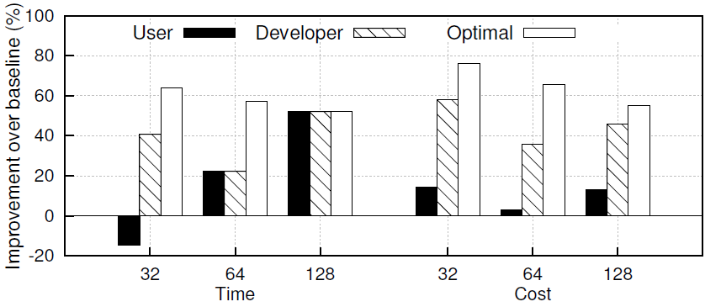
How to Configure Optimally?
Configure I/O system by hand ^{[Heshan’11]}
Hard
Obvious gaps between manual configurations and optimal ones
Expensive
Try all configurations for one application
Configuration burden to scientific users
Time- and money-consuming
Notes:
Confident users may try to do this by hand.
We invited an experienced user and a developer to configure the I/O system for the mpiBLAST application from 32 configuration candidates.
And compared the total run time and cost of their configurations with the result of the optimal one.
The black bars are the performance improvement of user selected configurations, the dotted bars are the performance improvement of developer selected configurations, and the white bars are the optimal ones of all the candidates.
Conservative users would like to try all configurations for their applications and select the optimal one for the future runs.
For example, performance variance should be considered for one trial

Slide 10
Our Approach
Automatically predict and select optimal I/O configurations
Map workload I/O characteristics to configurations
Workload I/O Characteristics
I/O System Configuration Options
Name | Value
Number of all processes | {32, 64, 128, 256}
Number of I/O processes | {32, 64, 128, 256}
I/O interface | {POSIX, MPIIO}
I/O iteration count | {1, 10, 100}
Data size | {1, 4, 16, 32, 128, 512} MB
Request size | {256KB, 4MB,16MB, 128MB}
Read and/or write | {read, write}
Collective | {yes, no}
File sharing | {share, individual}
Name | Value
Disk device | {EBS, ephemeral}
File system | {NFS, PVFS2}
Instance type | {cc1.4xlarge, cc2.8xlarge}
I/O server number | {1, 2, 4}
Placement | {part-time, dedicated}
Stripe size | {64KB, 4MB}
15 dimension > 1M

Slide 11
Outline
Motivation
Challenges
Methodology
Evaluation
Conclusion
Notes:
Here is the out line of this talk.
After introduced the motivation,
we define the problem and then propose our tool to address it.
We will show some interesting results and conclude it briefly.

Slide 12
Overview
Cloud System
I/O Configuration
Application I/O
Characteristic
15-Dimension
Exploration Space
Application’s IO
Characteristics
Query Conditions
ACIC
Dimension Reducer
Reduced
Exploration Sets
Prediction Model
(CART)
I/O Characteristic
I/O Configuration
Training Database
Train
Input
Configure
Query Result
Run
Insert
IOR
Target Cloud
Recommended I/O Configuration
Notes:
To sample the training data from the exploration space, we need a smarter way than choosing randomly.
We later realized that the parameters differ from each other in importance.
So it’s straightforward to reduce the exploration space by choosing the top parameters and train all their sampled combinations to bootstrap, then we can add more parameters incrementally

Slide 13
Dimension Reducer
Identify relative importance of parameters (PB Matrix ^{[Plackett’46]})
[4, 100]
Row | Parameters |  |  |  |  | Perf. Value
 | A | B | C | D | E
1 | 1 | 1 | 1 | -1 | 1 | 19
2 | -1 | 1 | 1 | 1 | -1 | 21
3 | -1 | -1 | 1 | 1 | 1 | 2
4 | 1 | -1 | -1 | 1 | 1 | 11
5 | -1 | 1 | -1 | -1 | 1 | 72
6 | 1 | -1 | 1 | -1 | -1 | 100
7 | 1 | 1 | -1 | 1 | -1 | 8
8 | -1 | -1 | -1 | -1 | -1 | 3
Effect Value | 40 | 4 | 48 | 152 | 28
Rank | 3 | 5 | 2 | 1 | 4
48
Sample PB design working with N = 5 and N’ = 8
Notes:
We use a magical technique called PB matrix to evaluate the importance of the parameters so that we can select the most important parameters from the huge exploration space.
PB matrix was proposed for agricultural crops experiment design and quality control in manufacturing, it’s able to evaluate the parameters’ importance using a few of experiment trials.
Because in the cloud computing, it takes time and money to run the trials.
There are five parameters in this example table, ABCDE. We use the recipe PB matrix and there are 8 rows for this sample.
For each run, the value for each parameter is set according to one row of the PB Matrix, whose elements are assigned with binary values (either “+1” or “-1”) based on pre-specified PB design rules. For example, in the first row, we use high value for all parameters except D, which will use the low value.
The “high” and “low” values are selected to be at the two ends of the parameter value range.
After the runs are completed, the importance of each parameter is calculated as the dot product of the parameter and the result column.
In this example, parameter D is considered most important and parameter B is considered least important.

Slide 14
Parameter Ranks
Rank | Name | Value
1 | Data size | {1, 4, 16, 32, 128, 512} MB
2 | Read and/or write | {read, write}
3 | I/O server number | {1, 2, 4}
4 | Number of I/O processes | {32, 64, 128, 256}
5 | File system | {NFS, PVFS2}
6 | Stripe size | {64KB, 4MB}
7 | Placement | {part-time, dedicated}
8 | Request size | {256KB, 4MB,16MB, 128MB}
9 | I/O interface | {POSIX, MPIIO}
10 | Disk device | {EBS, ephemeral}
11 | Collective | {yes, no}
12 | Instance type | {cc1.4xlarge, cc2.8xlarge}
13 | I/O iteration count | {1, 10, 100}
14 | Number of all processes | {32, 64, 128, 256}
15 | File sharing | {share, individual}
Notes:
This table lists the rank of all the 15 parameters, as well as the sampled values.
We use the top 10 parameters to bootstrap ACIC.
More parameters can be added later using this rank as guidance..

Slide 15
Overview
Target HPC
Application
IO Profiler
15-Dimension
Exploration Space
Application’s IO
Characteristics
Query Conditions
ACIC
Dimension Reducer
Reduced
Exploration Sets
Prediction Model
(CART)
I/O Characteristic
I/O Configuration
Training Database
Train
^{[Olshen’84]}
Input
Configure
Query Result
Run
Insert
IOR
Target Cloud
Recommended I/O Configuration
^{[shan’08]}
Crowd-Sourcing
Notes:
Run the synthetic benchmark named IOR
Vary parameter to mimic different behaviors
Set up I/O system with all configuration candidates
Collect results for different targets: Performance, or Cost
By continuous, crowd-sourcing training, the ACIC can effortlessly deal with cloud hardware/software upgrades with common data aging methods.
Why CART?
Obvious difference in importance of parameters
Simple, flexible, and interpretable
We can tolerate absolute prediction error as long as the rank of the configuration is close to the real one.

Slide 16
CART Example
…
REQUEST <= 34MB
…
STD = 0.147
AVG = 1.9
FILE SYSTEM
PVFS2
NFS
STD = 0.069
STD = 0.202
AVG = 2.2
AVG = 1.3
DATA_SIZE
DATA_SIZE
<= 24MB
> 24MB
<= 24576 KB
> 24576 KB
STD = 0.041
STD = 0.066
STD = 0.03
STD = 0.014
AVG = 2.1
AVG = 2.4
DEVICE
AVG = 1.6
AVG = 0.8
EBS
ephemeral
STD = 0.001
STD = 0.006
AVG = 2.0
AVG = 2.2
(…,request_size = 4MB, data_size = 16MB, …, file_system = PVFS2)
Notes:
Here is a CART example.
There are two kinds of node in a decision tree, internal nodes and leaf nodes.
Each internal node has a predictor to split the values into two sub-groups. The left child and the right child.
To build this tree, every internal node is split if the variance of the values is large enough.
Each leaf node has the final sub-group value, indicating by the AVG field.
For each input, we can get the final value by traversing from the root node to this node.

Slide 17
Overview
15-Dimension
Exploration Space
Application’s IO
Characteristics
Query Conditions
ACIC
Dimension Reducer
Reduced
Exploration Sets
Prediction Model
(CART)
I/O Characteristic
I/O Configuration
Training Database
Train
Input
Configure
Query Result
Run
Insert
IOR
Target Cloud
Recommended I/O Configuration
Notes:
Now we introduced the three parts of ACIC.

Slide 18
Outline
Motivation
Challenges
Methodology
Evaluation
Experiment Setup
Effectiveness
Training Cost
Conclusion
Notes:
Let’s see some interesting data.

Slide 19
Evaluation - Platform
Amazon Cluster Computing Instance
2 * 8-core Intel Xeon CPU, 60.5GB RAM
10 Gigabit Ethernet
Amazon Linux AMI, Intel compiler & MPI runtime
Storage Device
Ephemeral
EBS (Elastic Block Store)
Software RAID
Baseline Configuration
NFS, dedicated, 1 EBS device
Notes:
We choose this baseline because it’s simple and popular.

Slide 20
Evaluation - Applications
Selected HPC Workloads
Name | Domain | CPU | Network | Read/Write | API
BTIO | Physics | High | High | Write | MPIIO
FLASHIO | Astrophysics | Low | Low | Write | MPIIO
mpiBLAST | Biology | Medium | Medium | Read | POSIX
MADbench2 | Cosmology | Low | Medium | Read & Write | MPIIO
Notes:
Selected application differ from each other in many characteristics including the scientific area, CPU/network usage, read/write and APIs.

Slide 21
Evaluation - No One Excels All
Optimal Performance Configurations
App. | Proc. | Device | P/D | FS | IO Servers | Strip Size
BTIO | 64 | EBS | P | NFS | 1 | N/A
 | 256 | eph. | P | PVFS2 | 4 | 4MB
FLASHIO | 64 | eph. | D | NFS | 1 | N/A
 | 256 | eph. | P | NFS | 1 | N/A
mpiBLAST | 32 | eph. | P | PVFS2 | 4 | 64KB
 | 64 | eph. | D | PVFS2 | 4 | 4MB
 | 128 | eph. | D | PVFS2 | 4 | 4MB
MADbench2 | 64 | eph. | D | PVFS2 | 4 | 4MB
 | 256 | EBS | D | PVFS2 | 4 | 4MB
9
test
cases
7 unique
configs
Guess?
7/9: It’s difficult to guess optimal one even within the 5-D space.
Notes:
There are 9 cases composed by application as well as the scale.

Slide 22
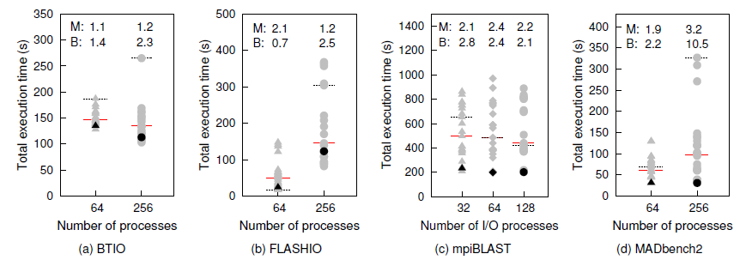
Effectiveness of Exec. Time Optimization
Baseline
Median
ACIC
Large performance range under different configurations
Near optimal configurations predicted by ACIC
Notes:
We exhaustively tested all candidate configurations sampled before by running the 4 applications at different scales.
The total run time with each configuration is indicated by a gray dot.
The vertical span of gray dots depicts the range of measured total execution time for the entire configuration space.
The lowest dot in each figure is the measured optimal configuration.
The black points highlight the total run time under the ACIC recommended I/O configuration.
The solid red line marks the median performance among all configuration candidates,
while the dashed black line marks the performance of the baseline (B) I/O configuration.
Speedup ratios achieved by ACIC over the median and baseline are shown at the top of each figure.
First, these figures clearly demonstrate the potentially large difference, in overall execution time caused by different I/O system configurations
Second, ACIC is able to identify near-optimal I/O configurations in almost all situations, as the black points are located near the bottom of the gray “spectrum”.

Slide 23
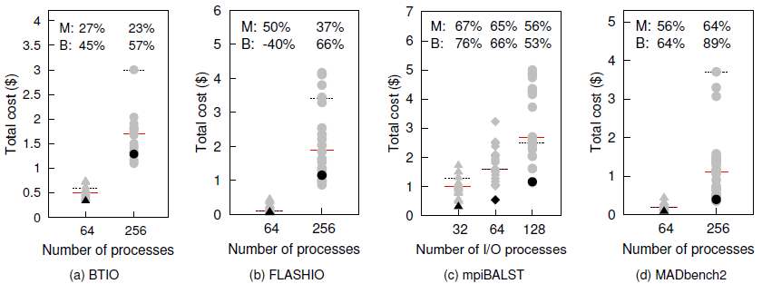
Effectiveness of Total Cost Saving
Even better results in total cost saving by ACIC
Notes:
The cost is calculated by the execution time, the number of instances and the price per instance per hour.

Slide 24
Training More Data
100,000$ × c
1000$ × c
More training data points, higher prediction accuracy
The gain is heavily application-dependent
Training cost increases exponentially
Notes:
This figures presents the results of parameter sensitivity using four sample runs, one for each application.
The x axis indicates the number of top ranking parameters used in model training as ordered by PB matrix.
For each parameter count, the y axis on the left measures the performance of the ACIC top recommendation in terms of cost saving over the baseline,
while the y axis on the right measures the cost of training data collection.
When using 10 parameters, the total training data collection cost is around $1K

Slide 25
Outline
Motivation
Challenges
Methodology
Evaluation
Conclusion
Notes:
Here is the out line of this talk.
After introduced the motivation,
we define the problem and then propose our tool to address it.
We will show some interesting results and conclude it briefly.

Slide 26
Conclusion
I/O configurations is crucial to HPC in cloud
Manual configuration is error-prone even for experts
Automatic I/O configurator is helpful
Building a prediction model is challenging
Reduce high dimensional space to sample training data
Reuse training data in crowd-sourcing way to amortize cost

Slide 27
Thanks!
http://hpc.cs.tsinghua.edu.cn/ACIC
Thank Heshan Lin and Ruini Xue for joining user study
Thank anonymous reviewers for their useful comments
Supported in China: 863 NO.2012AA01A302, NSFC 61133006 and 61103021
Supported in U.S.: NSF awards (CNS-0546301, CNS-0915861, and CCF-0937908)
Notes:
We published ACIC to the HPC community. Users can download the training database and build the CART model to predict the optimal I/O system configurations for their applications.
New contributions are heavily welcome.
Please scan this bar code and visit the homepage of ACIC.
That’s all thank you!

Slide 28
References
[Yan’11] Y. Zhai, M. Liu, J. Zhai, X. Ma, and W. Chen. Cloud Versus In-house Cluster: Evaluating Amazon Cluster Compute Instances for Running MPI Applications. In SC. ACM, 2011.
[Plackett’46] R. Plackett and J. Burman. The Design of Optimum Multifactorial Experiments. Biometrika, 1946.
[Olshen’84] L. Olshen and C. Stone. Classication and Regression Trees. Wadsworth International Group, 1984.
[Mesnier’07] M. Mesnier, M. Wachs, R. Sambasivan, A. Zheng, and G. Ganger. Modeling the Relative Fitness of Storage. In SIGMETRICS. ACM, 2007.
[Mingliang’11] Mingliang Liu and Jidong Zhai and Yan Zhai and Xiaosong Ma and Wenguang Chen. One Optimized I/O Configuration per HPC Application: Leveraging The Configurability of Cloud. In APSys. ACM, 2011.
[Heshan’11] H. Lin, X. Ma, W. Feng, and N. Samatova. Coordinating Computation and I/O in Massively Parallel Sequence Search. IEEE Transactions on Parallel and Distributed Systems, 2011.
[Shan’08] H. Shan, K. Antypas, and J. Shalf. Characterizing and Predicting the I/O Performance of HPC Applications Using a Parameterized Synthetic Benchmark. In SC. IEEE, 2008.

